Slide 1
Week 35:
logo
Cambridge Listening
Friday, May 12th
<<time>>
<<02:00->>
Notes:
Timer extension: https://www.claycodes.org/google-add-onsextensions/slides-timer
Ready Set Go CC BY 4.0 https://freesound.org/s/44704/
Analog-hammered-chime alarm clock CC BY 4.0 https://freesound.org/s/198841/
Party pack CC BY 4.0 https://freesound.org/s/484267/
Service bell sounds CC BY 3.0 https://freesound.org/s/78404/
Indoor crowd sounds CC0 1.0 https://freesound.org/s/340360/

Slide 2
[TPR]s
total physical response
<<date>>
<<time>>
[CM] Classroom Management
[TDR]s total digital response
lesson unit & title
countdown extension
company logo
[idm] framework
date extension
time extension
school logo
google translate
ICQ/CCQs
Notes:
21st Century
methodological signposting

Slide 3
in order to fully benefit from the technologies used throughout this lesson, during the presentation, a presenter with
click-switch function is needed.

Slide 4
aluzie la grammar lesson
logo
<<time>>
Week 33
2nd Conditional
p. 89-90

Slide 5
logo
<<time>>
Notes:
Use https://www.bitmoji.com/ to create an avatar.
Add Slides Timer extension to your browser: https://chrome.google.com/webstore/detail/slides-timer/nfhjdkmpebifdelclimjfaackjhiglpc?hl=en

Slide 6
logo
<<time>>
Notes:
Your CM for Secondary students should emphasize specific struggles for this difficult age, and ways to solve them. Plan your CM accordingly.

Slide 7
logo
<<time>>
Notes:
Don’t stick to the usual CM rules used for Primary (such as Be quiet!; Be nice!; Sit nicely!, etc.)
Create your Secondary CM rules based on both age and language abilities. You can even grade your CM rules so as to comprise grammar/language features, idioms, etc. Be inventive!

Slide 8
logo
<<time>>
Notes:
Useful websites:
https://giphy.com/
https://www.bitmoji.com/
Slides Timer

Slide 9
logo
<<time>>
Notes:
Keep your CM rules short and concise. 5 rules should be more than enough.

Slide 10
logo
<<time>>
Notes:
Don’t forget to include at least 1 rule associated with students’ well-being. It’s vital for this group of age. Some other good examples of such rules would be: I am enough; I can do it; I approve of myself, etc.

Slide 11
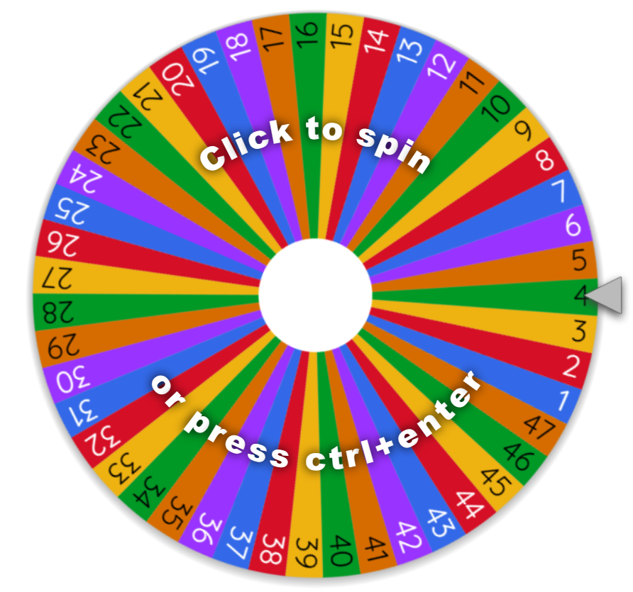
logo
<<time>>
10.00
Notes:
Presentation slide.
As long as the heart stays at 10.00 there will be a spinning wheel at the end of the lesson. One student to win a treat (candy, sticker, pencil, snack, etc). On the wheel, there are numbers from 1 to 50, or as many students are in the class at the time.
CM>>>> https://docs.google.com/presentation/d/1BXm29jtamP-B-asmOc_ZlVNaM9P5hAnZIkaWLZMFzQ0/edit?usp=sharing

Slide 12
logo

Slide 13
aluzie la grammar lesson
logo
<<time>>
Week 33
2nd Conditional
p. 89-90

Slide 14
logo
<<date>>
<<time>>
Notes:
Grammar lesson plan J8 adapted for PS 45 min 9th grade: [grammar/lesson plan/staging/stage 1(2)/review vocabulary past lesson *unit]

Slide 15
logo
<<date>>
<<time>>
Vocabulary
Notes:
Presentation slide

Slide 16
logo
<<date>>
<<time>>
Guess the word!
Look!
Take turns!
Speak!
Notes:
CCQ/ICQs

Slide 17
logo
<<date>>
<<time>>
What is it?
It’s a plant.
thực vật

Slide 18
<<date>>
<<time>>
What is it?
It’s a UFO.
đĩa bay

Slide 19
<<date>>
<<time>>
What is it?
It’s a gemstone.
đá quý

Slide 20
(eng.) amethyst
=
(viet.) ametit
=
(rom.) ametist
(rom.) amețit
=
(viet.) chóng mặt
=
(eng.) dizzy

Slide 21
<<date>>
<<time>>
What are they?
They are minerals.
khoáng vật

Slide 22
<<date>>
<<time>>
What is it?
It’s a creature.
sinh vật

Slide 23
<<date>>
<<time>>
What is it?
It’s a meteor.
sao băng

Slide 24
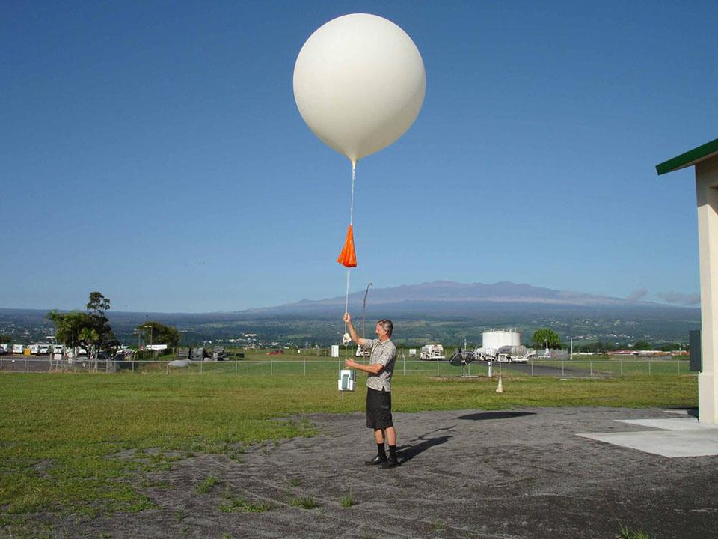
<<date>>
<<time>>
What is it?
It’s a
weather balloon.
Khinh khí cầu thời tiết

Slide 25
<<date>>
<<time>>
What are they?
Núi
They are mountains.

Slide 26
<<date>>
<<time>>
What is it?
It’s water.
Nước

Slide 27
<<date>>
<<time>>
What is it?
It’s gas.
khí

Slide 28
aluzie la grammar lesson
logo
<<time>>
Week 33
2nd Conditional
p. 89-90

Slide 29
<<date>>
<<time>>
What would you be
if you were
a gemstone?

Slide 30
<<date>>
<<time>>
If I were a gemstone,
I would be…

Slide 31
<<date>>
<<time>>
If I were a gemstone,
I would be an amethyst.

Slide 32
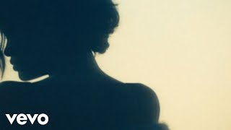
<<date>>
<<time>>
If I were a gemstone,
I would be a diamond.

Slide 33
aluzie la grammar lesson
logo
<<time>>
Week 33
2nd Conditional
p. 89-90

Slide 34
<<date>>
<<time>>
Matching

Slide 35
<<date>>
<<time>>
Speak!
Look!
Take turns!
Match!

Slide 36
<<2:50->>

Slide 37
Title
The Second Conditional
<<date>>
<<time>>
Form
IF + S + V2 ,
S + would + verb

Slide 38
Past Simple V2
& base form of the verb
<<date>>
Tenses
<<time>>
To give advice:
If I were you, I would start studying.
For imaginary situations:
If I had one billion dollars,
I would donate a half.
Used

Slide 39
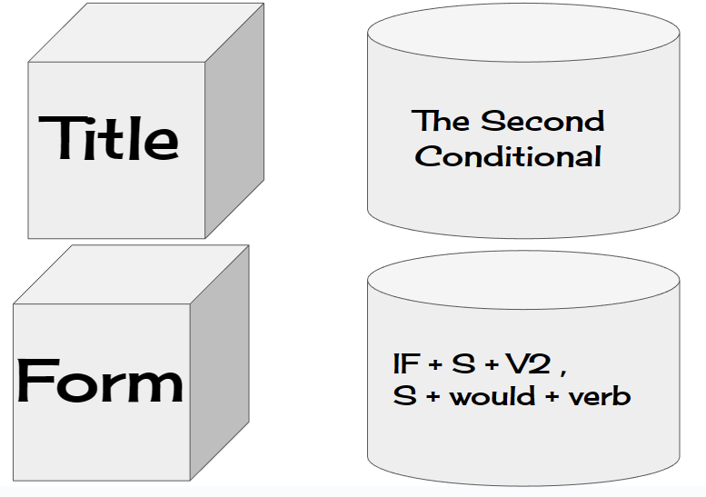
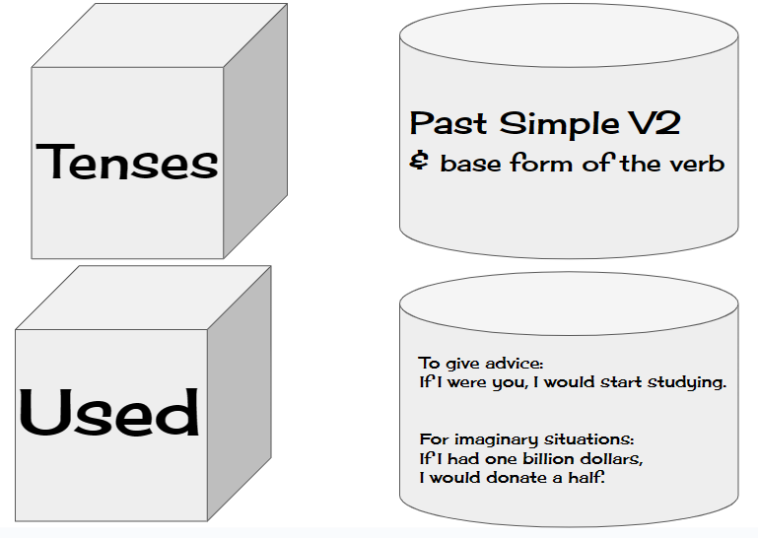
<<date>>
<<time>>

Slide 40
aluzie la grammar lesson
logo
<<time>>
Week 33
2nd Conditional
p. 89-90

Slide 41
<<date>>
<<time>>
Presentation

Slide 42
<<date>>
2nd Conditional
<<time>>
If Mr. Loc had a car, he would drive to work.

Slide 43
<<date>>
2nd Conditional
<<time>>
If Mr. Loc had a car,
IF + Subject + V2 (Past Simple) + Object

Slide 44
<<date>>
2nd Conditional
<<time>>
he would drive to work.
Subject + Would + Verb + Object

Slide 46
<<date>>
<<time>>
Conditional
Comma
Main sentence
If Mr. Loc had a car, he would drive to work.
IF + Subject + V2 (Past Simple) + Object
Comma, Subject + Would + Verb + Object
Mr. Loc would drive to work if he had a car.

Slide 47
aluzie la grammar lesson
logo
<<time>>
Week 33
2nd Conditional
p. 89-90

Slide 48
<<date>>
<<time>>
Look & Say

Slide 49
<<date>>
<<time>>
Guess the sentence!
Look!
Take turns!
Speak!

Slide 50
<<00:50->>

Slide 51
<<date>>
<<time>>
<<00:50->>

Slide 52
<<date>>
<<time>>
stay
at home
were
I
If
,
I
poor
would

Slide 53
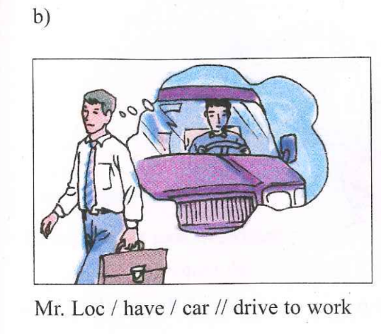
<<date>>
<<00:50->>
<<time>>
If Mr. Loc had a car,
he would drive to work.

Slide 54
<<date>>
<<time>>
a bike
I
I
had
,
would be
much healthier.
If

Slide 55
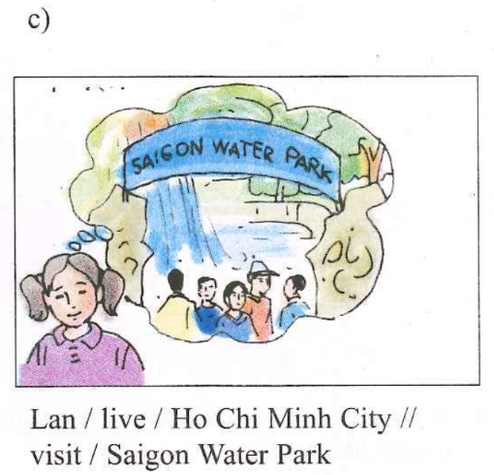
<<date>>
<<00:50->>
<<time>>
If Lan lived in Ho Chi Minh City,
she would visit Saigon Water Park.

Slide 56
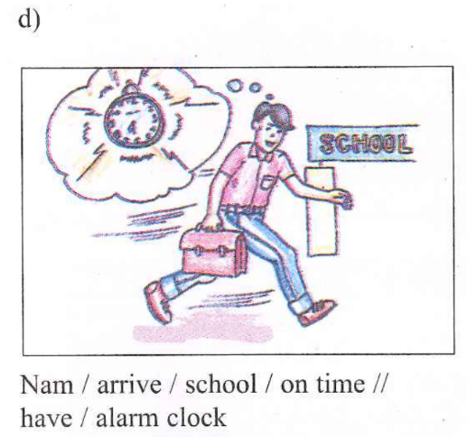
<<date>>
<<00:50->>
<<time>>
Nam would arrive at school on time
if he had an alarm clock.

Slide 58
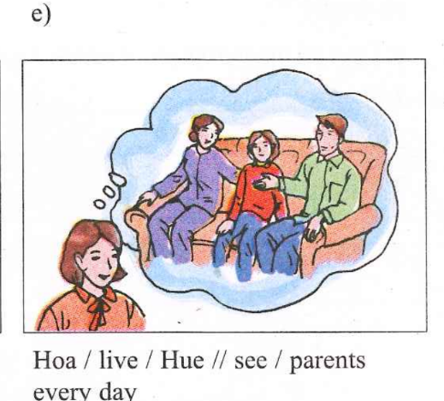
<<date>>
<<00:50->>
<<time>>
If Hoa lived in Hue,
she would see her parents every day.

Slide 59
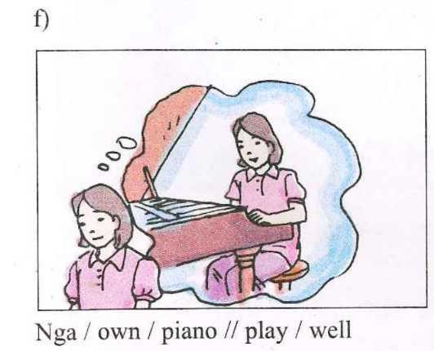
<<date>>
<<00:50->>
<<time>>
If Nga owned a piano,
she would play well.

Slide 60
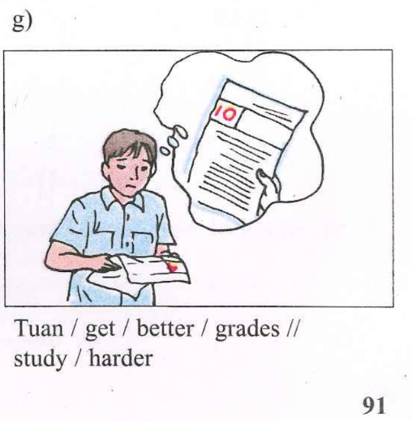
<<date>>
<<00:50->>
<<time>>
Tuan would get better grades,
if he studied harder.

Slide 61
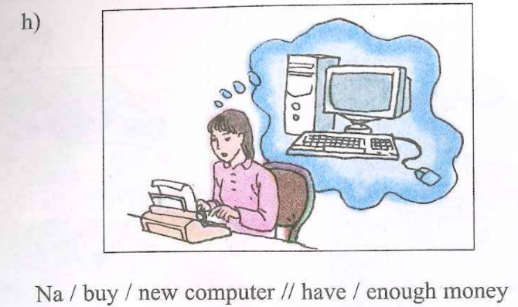
<<date>>
<<00:50->>
<<time>>
Na would buy a new
computer if she had enough money.

Slide 62
aluzie la grammar lesson
logo
<<time>>
Week 33
2nd Conditional
p. 89-90

Slide 63
If Mr. Val was sick, he would wear a mask.

Slide 64
If Mr. Val was a cat, he would live nine lives.

Slide 65
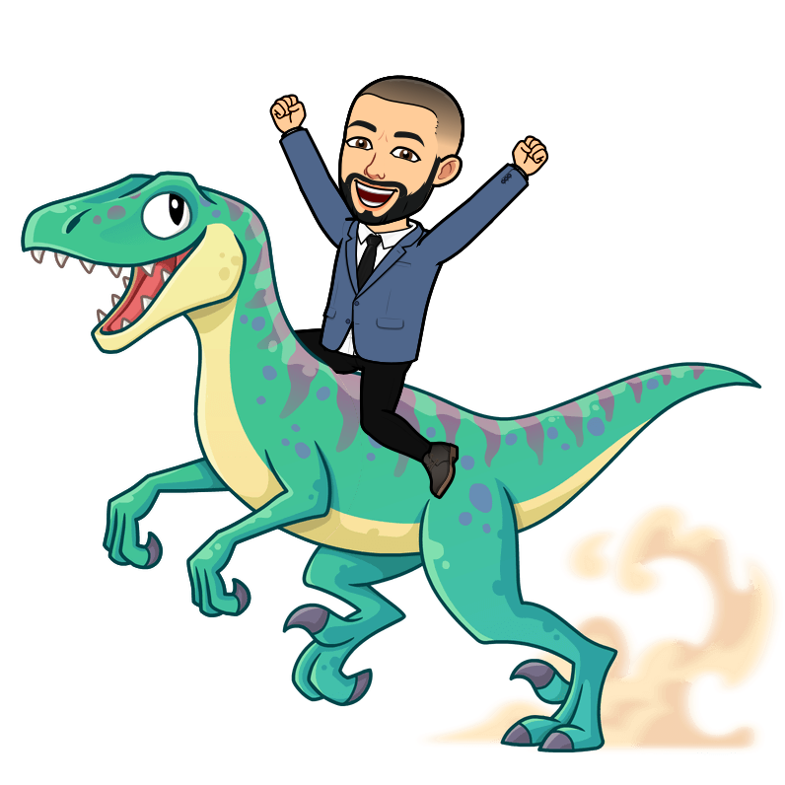
If Mr. Val was an animal, he would be a dinosaur.

Slide 66
If Mr. Val was a mineral, he would be an amethyst.

Slide 67
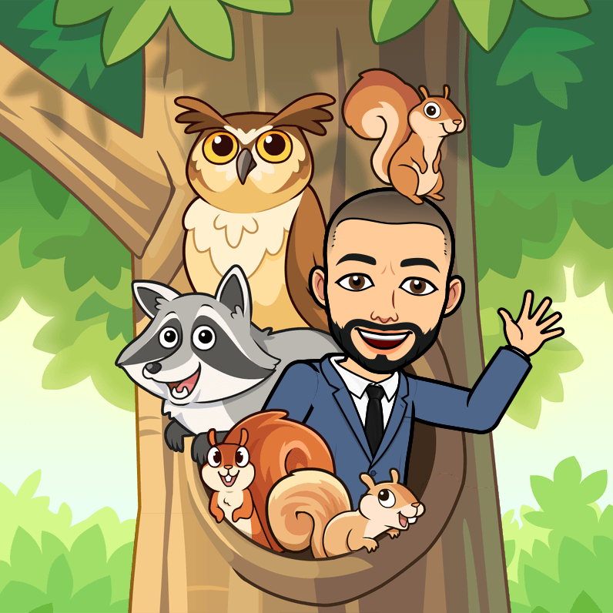
If Mr. Val was a bird, he would be an owl.

Slide 68
If Mr. Val was a celebrity, he would be an actor.

